Slide 1
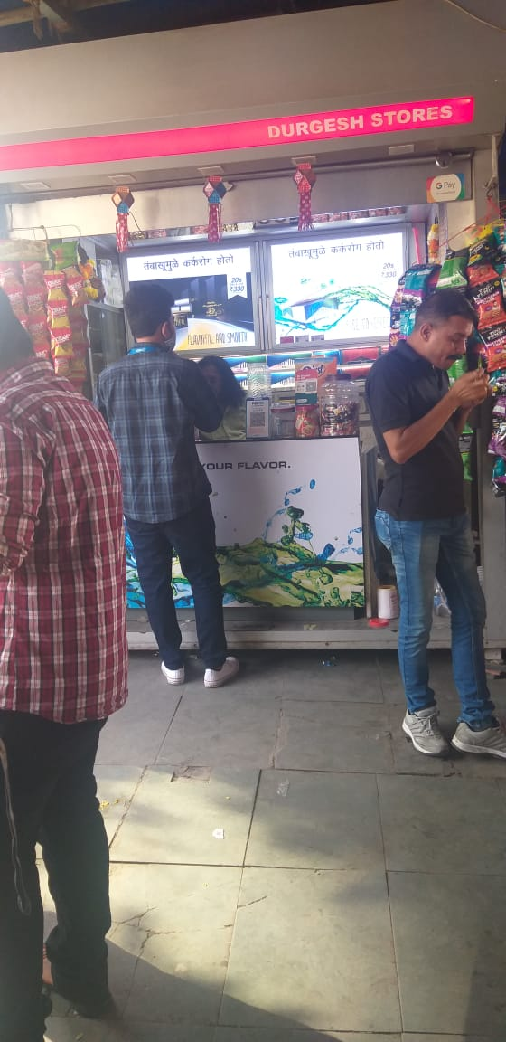
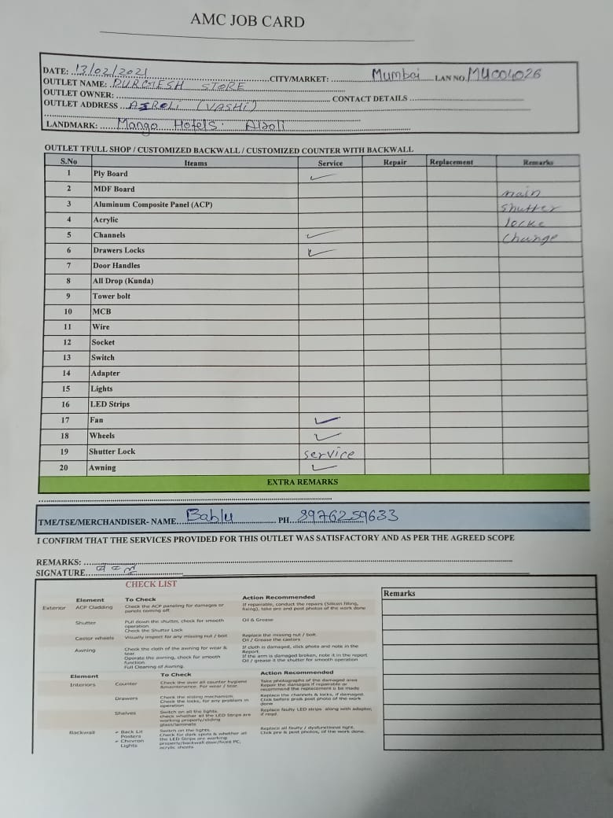
Outlet Name : DURGESH STORE
Address : VASHI
LAN Code : MU004026
TSE : YUGAL RANJAN
Mumbai – High Impact

Slide 2
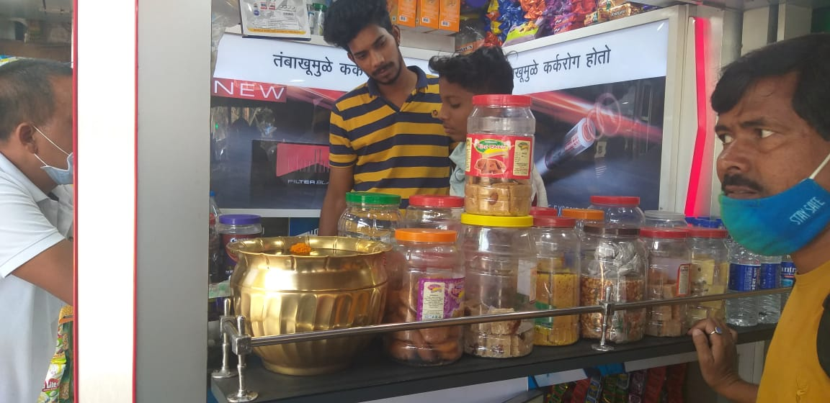
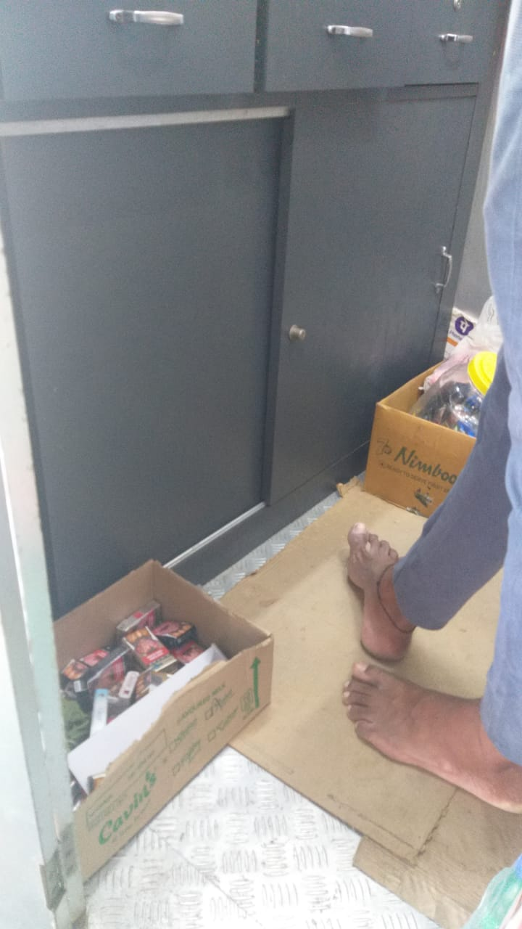
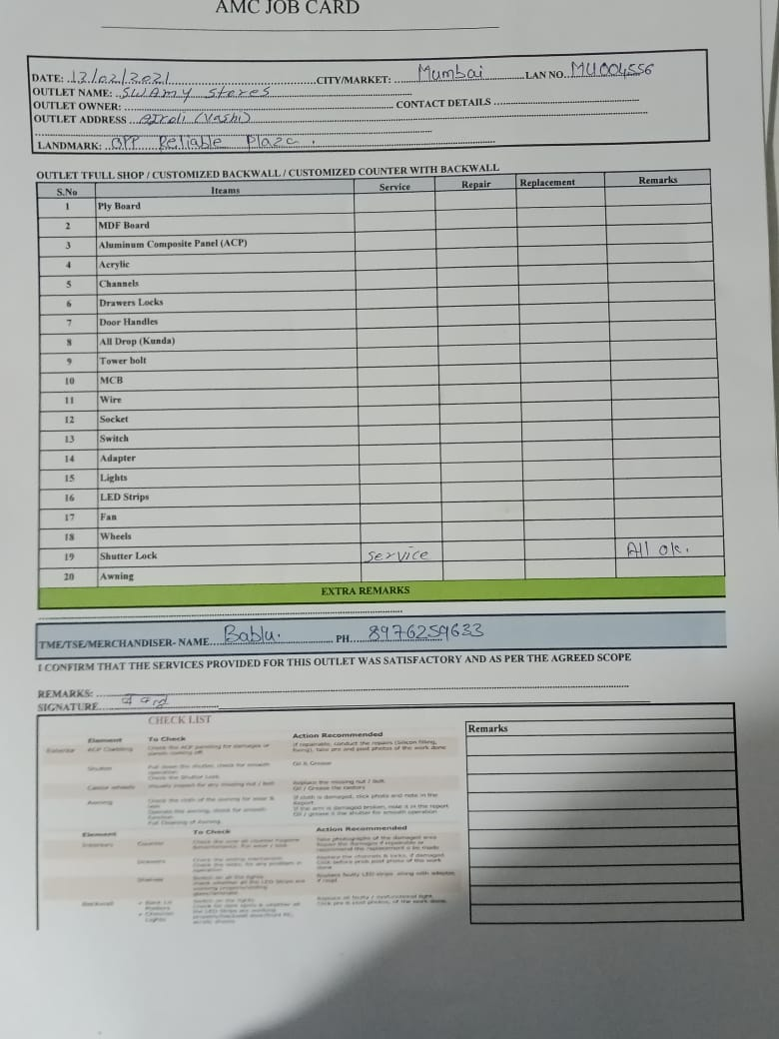
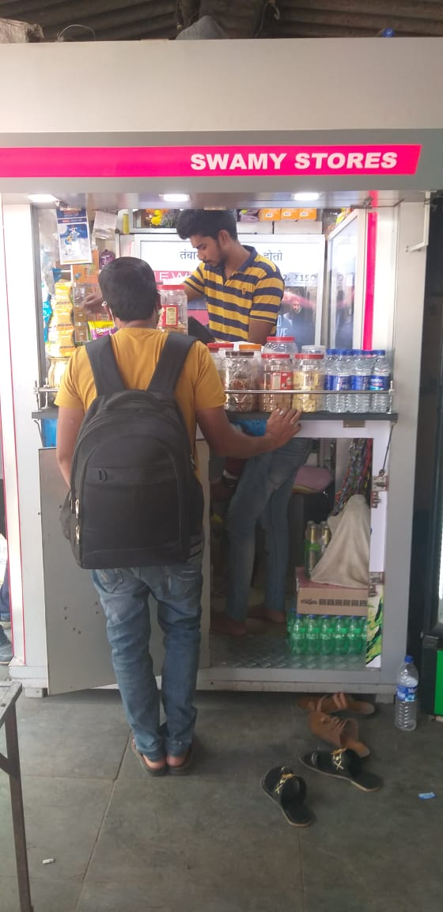
Outlet Name : SAWAMI PAN SHOP
Address : VASHI
LAN Code : MU004556
TSE : YUGAL RANJAN
Mumbai – High Impact

Slide 3
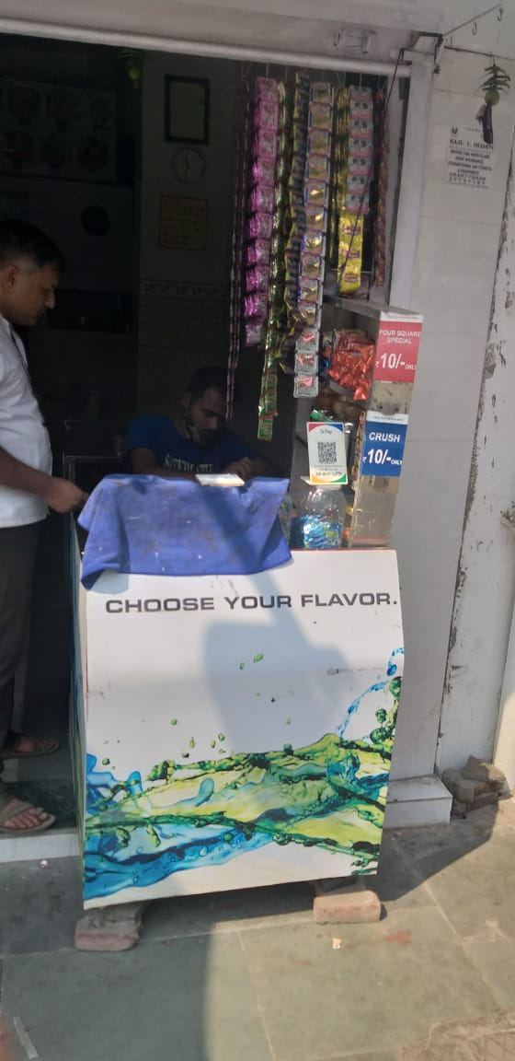
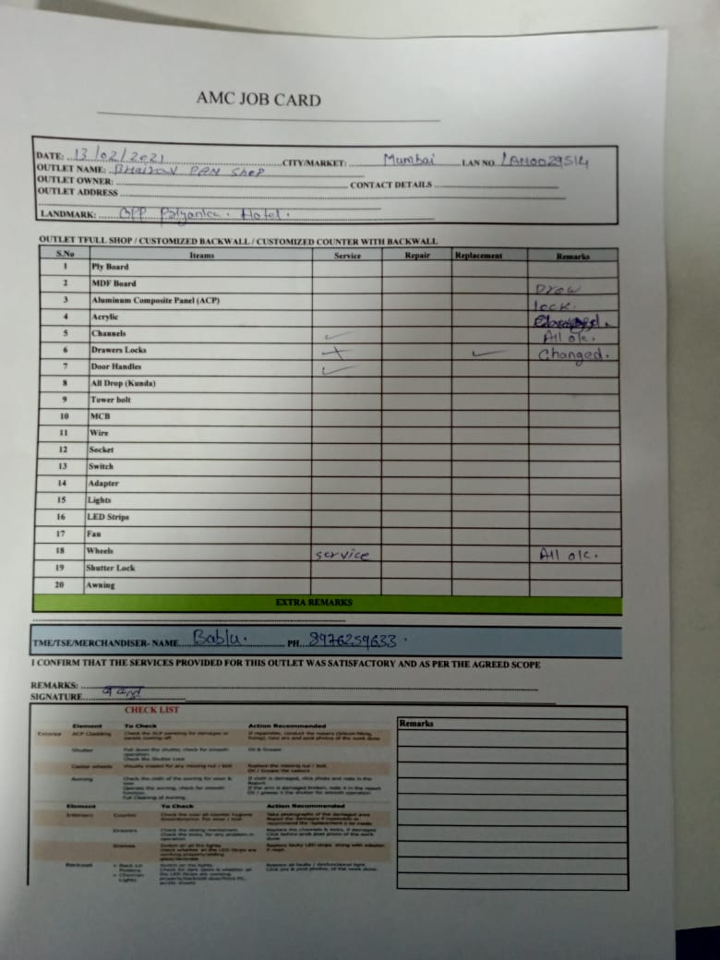
Outlet Name : BHAIRAV PAN SHOP
Address : AIROLI
LAN Code : LAN0029514
TSE :YUGAL RANJAN
Mumbai – Medium Impact

Slide 4
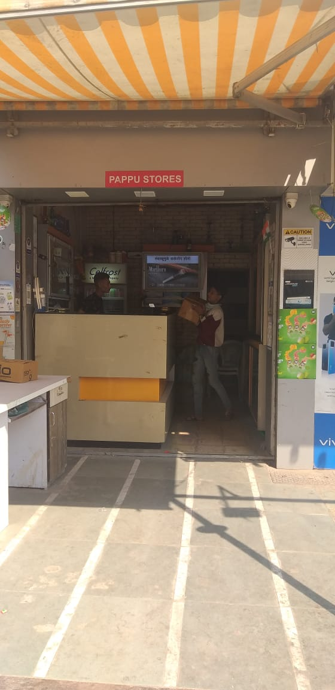
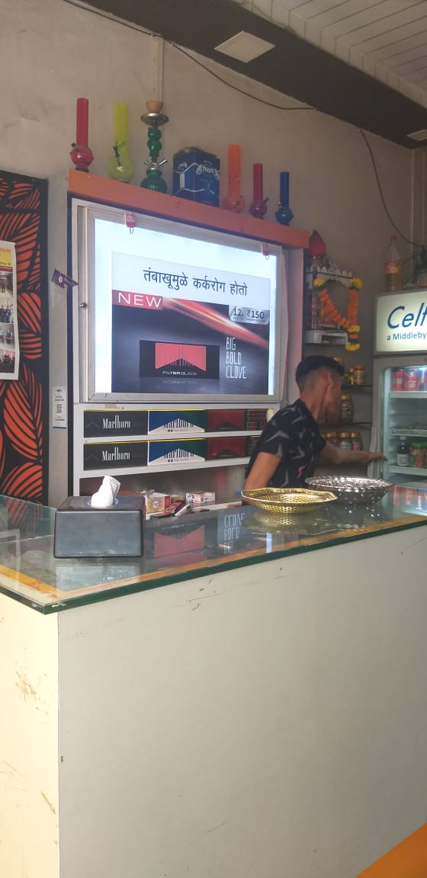
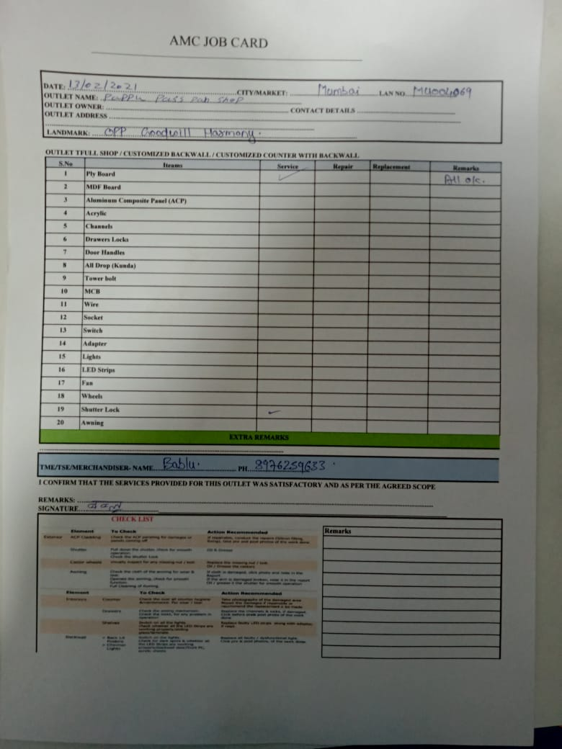
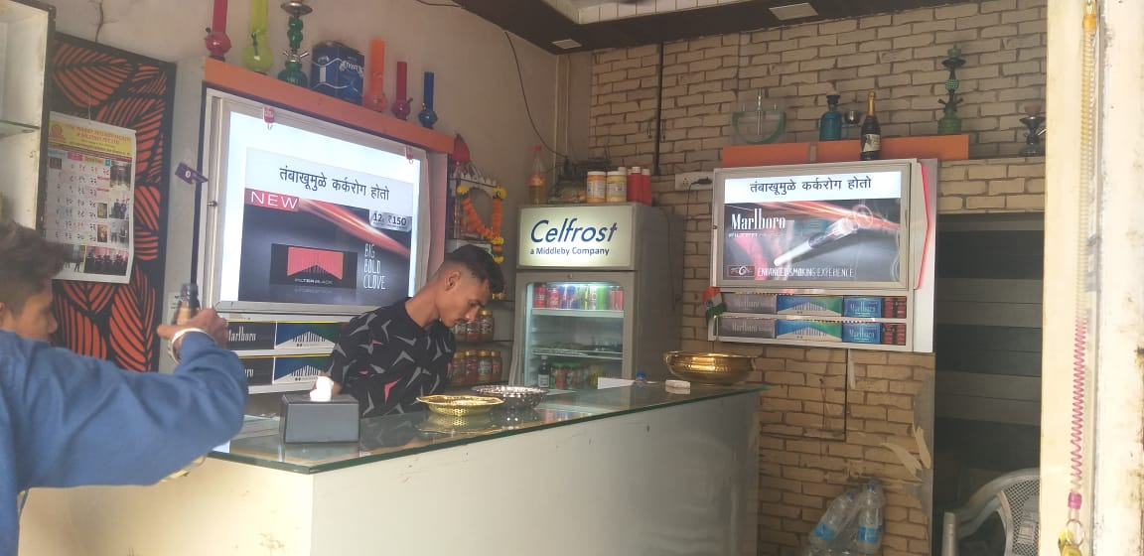
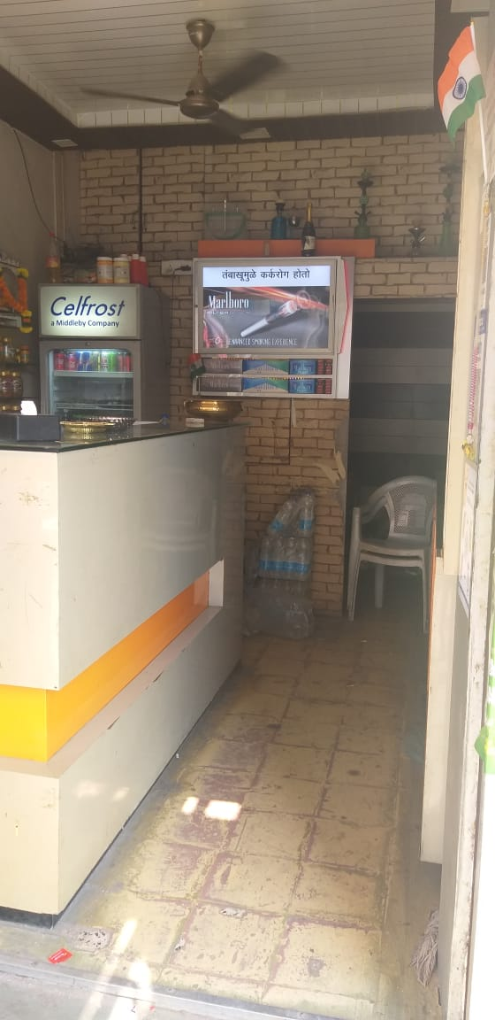
Outlet Name : PAPPU PASS PAN SHOP
Address : AIROLI
LAN Code : MU004069
TSE : YUGAL RANJAN
Mumbai – Medium Impact

Slide 5
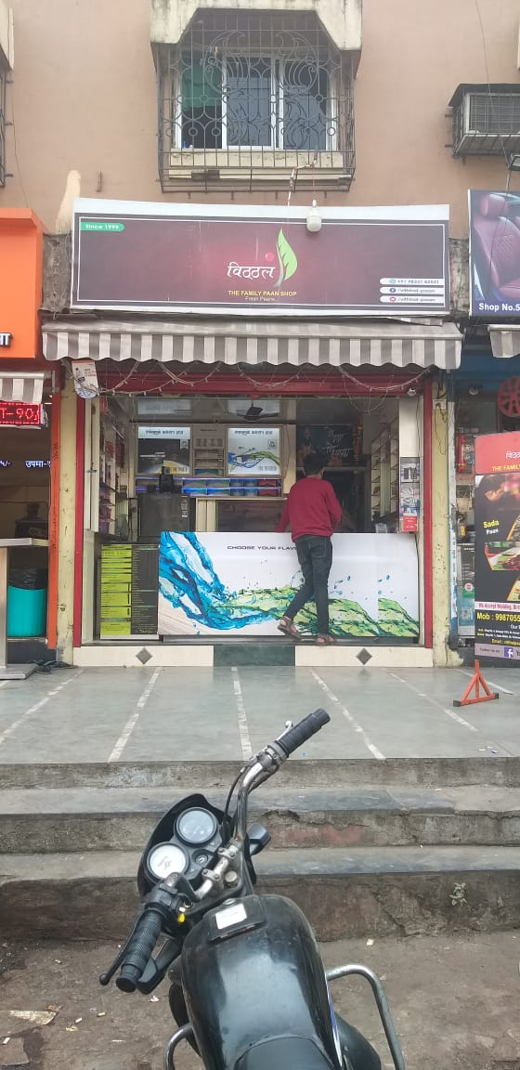
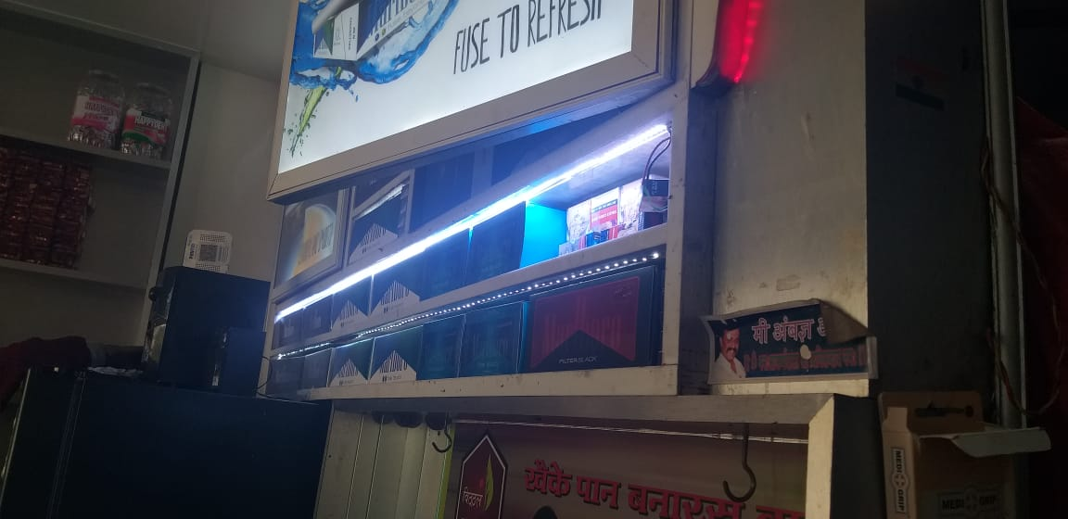
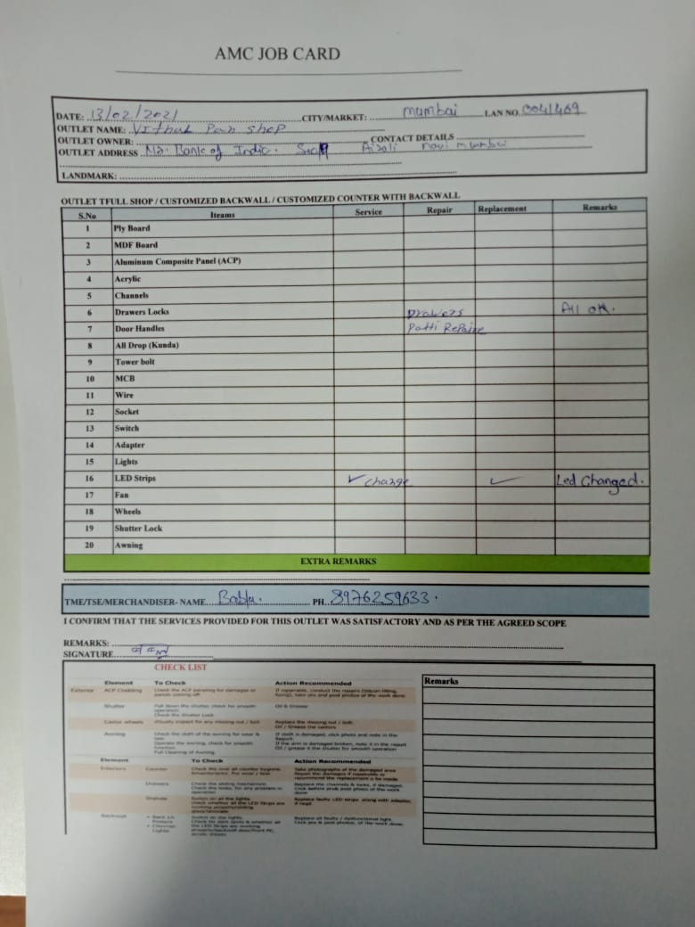
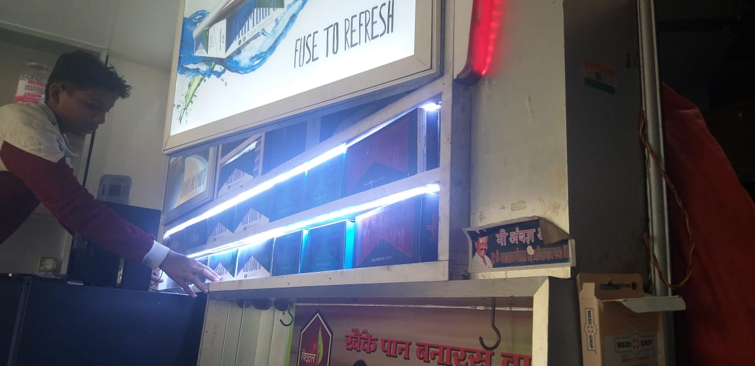
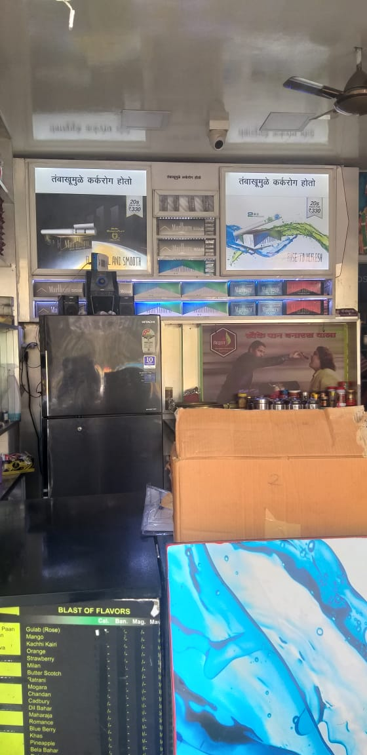
Outlet Name : VITHAL PAN SHOP
Address : AIROLI
LAN Code : LAN0041469
TSE : YUGAL RANJAN
Mumbai – High Impact

Slide 6
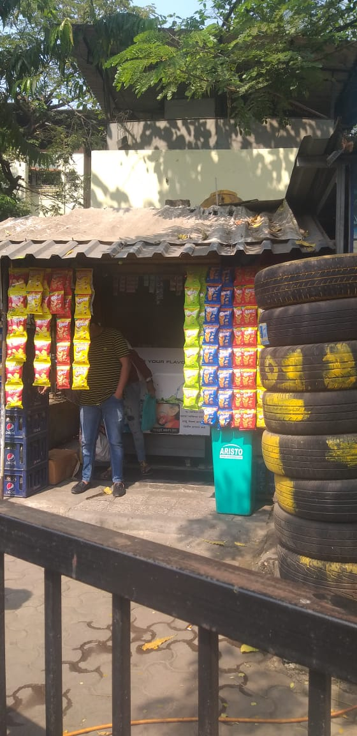
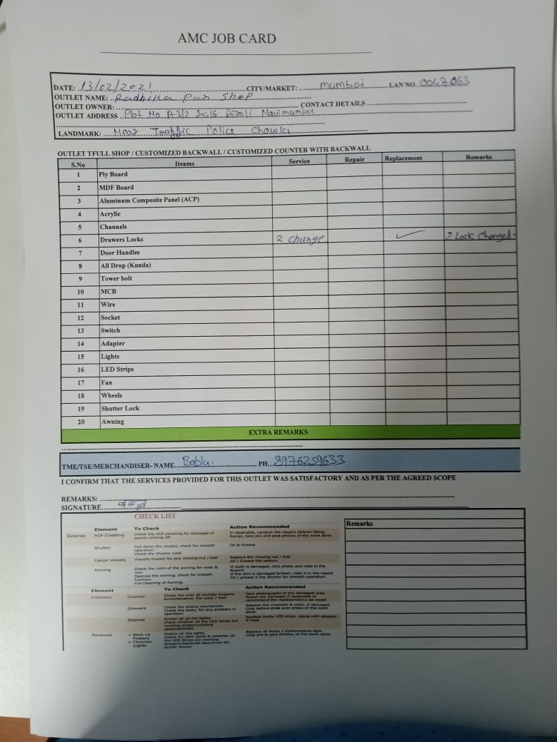
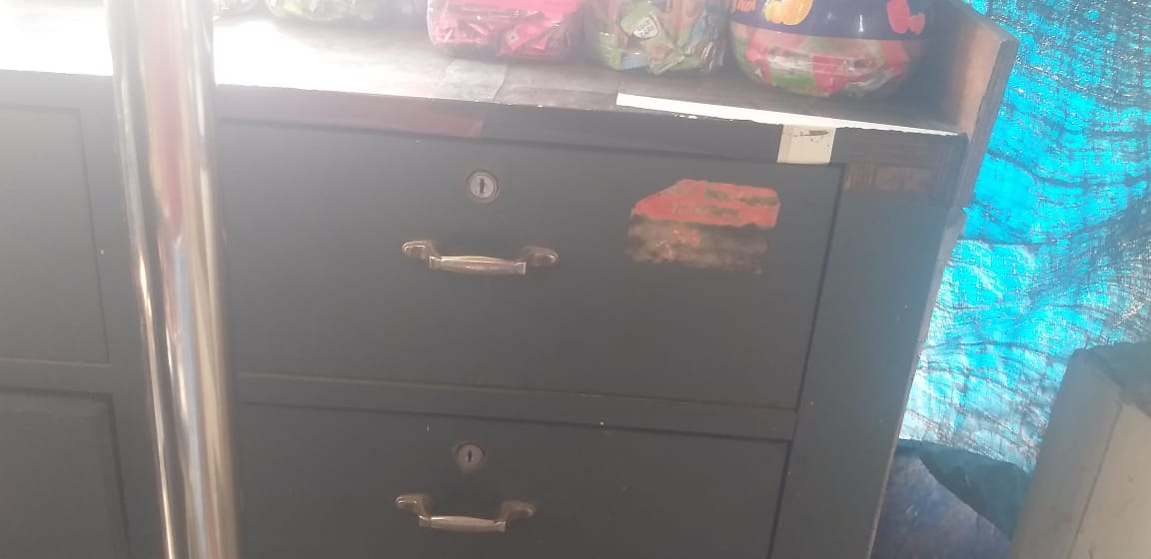
Outlet Name : RADHIKA PAN SHOP
Address : AIROLI
LAN Code : LAN0047063
TSE : YUGAL RANJAN
Mumbai – Medium Impact

Slide 7
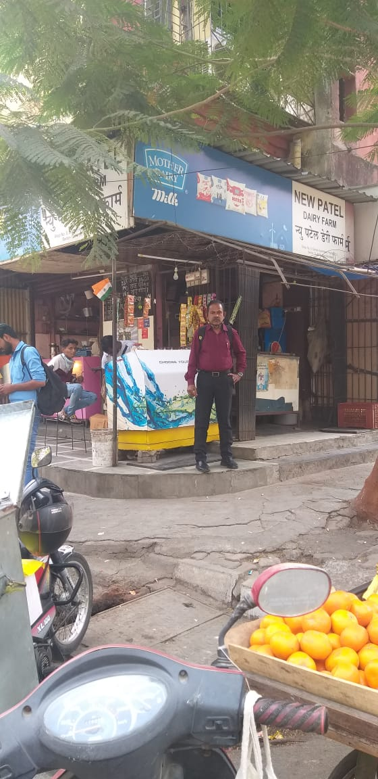
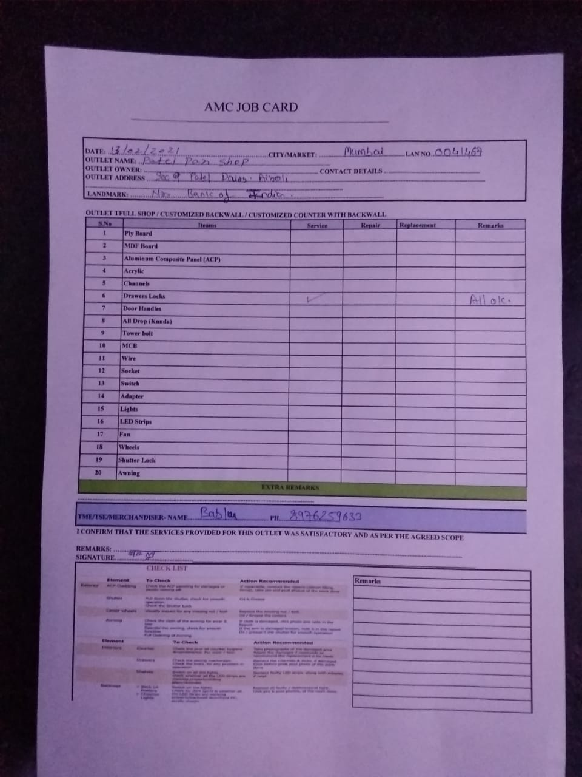
Outlet Name : PATEL PAN SHOP
Address : AIROLI
LAN Code : LAN0041467
TSE : YUGAL RANJAN
Mumbai – Medium Impact

Slide 8
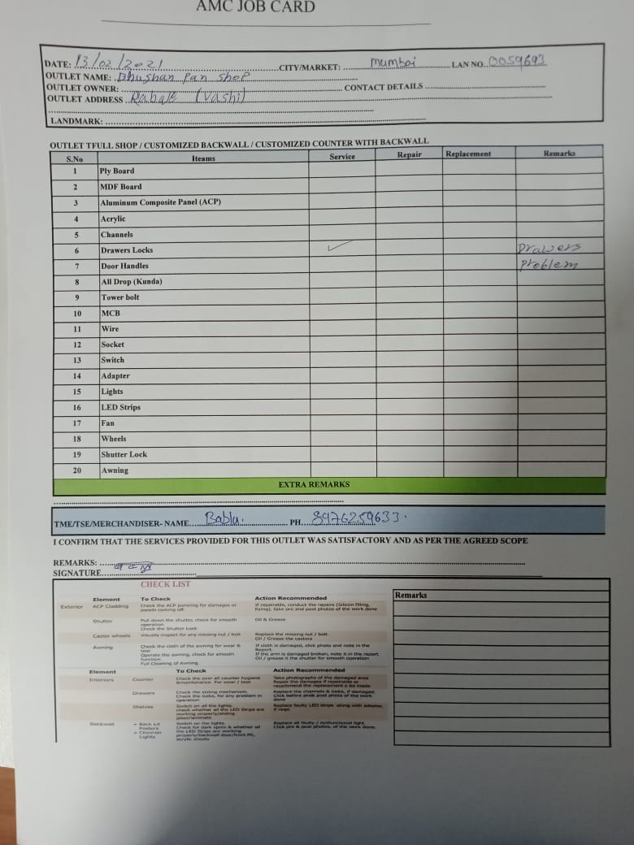
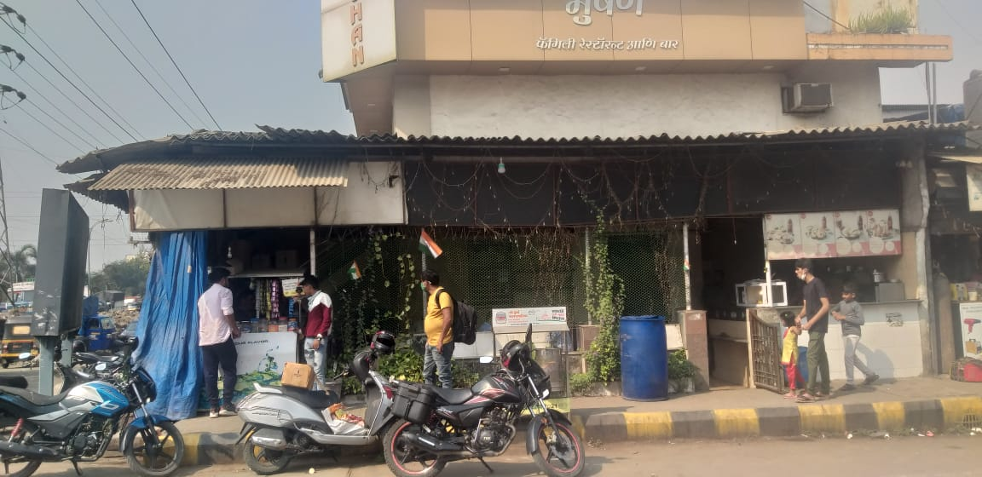
Outlet Name : BHUSHAN PAN SHOP
Address : RABALE
LAN Code : LAN0059693
TSE : YUGAL RANJAN
Mumbai – Medium Impact

Slide 9
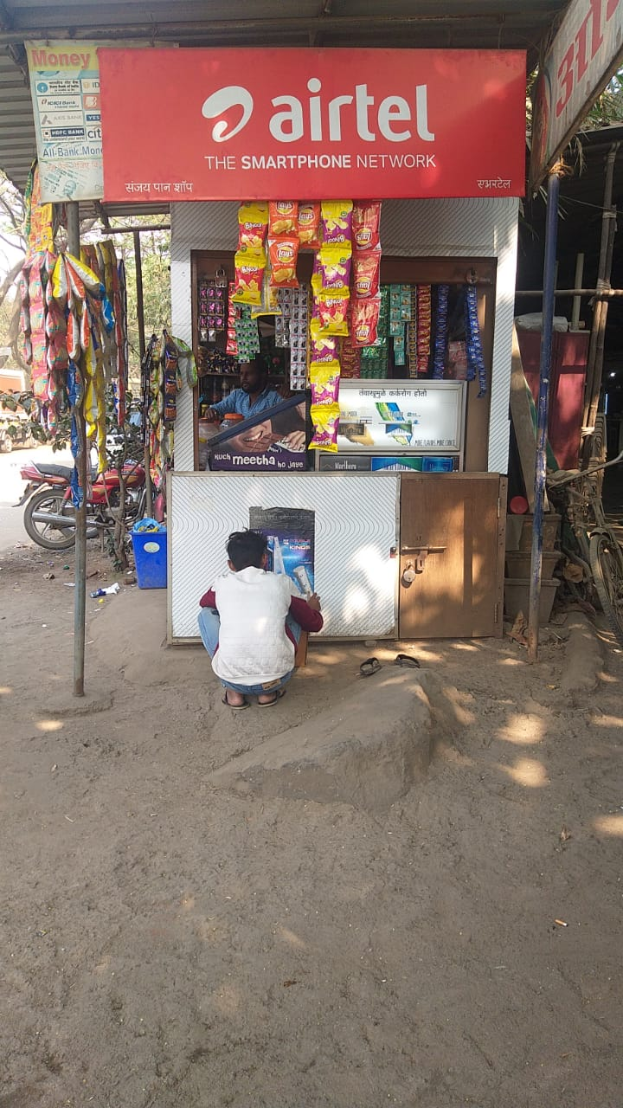
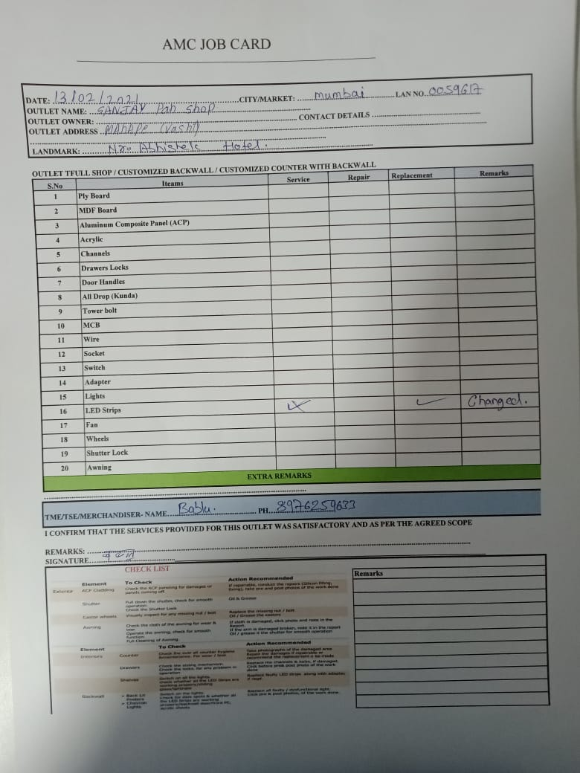
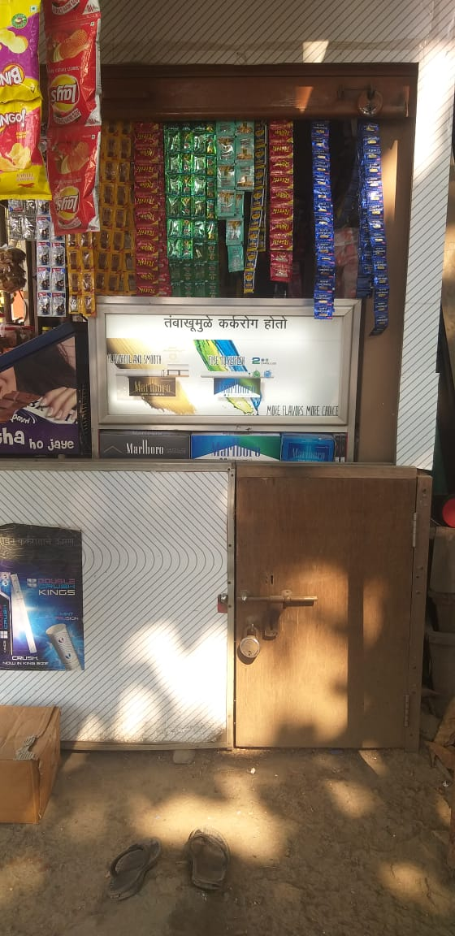
Outlet Name : SANJAY PAN SHOP
Address : MAHAPE
LAN Code : LAN0059617
TSE : YUGAL RANJAN
Mumbai – Medium Impact

Slide 10
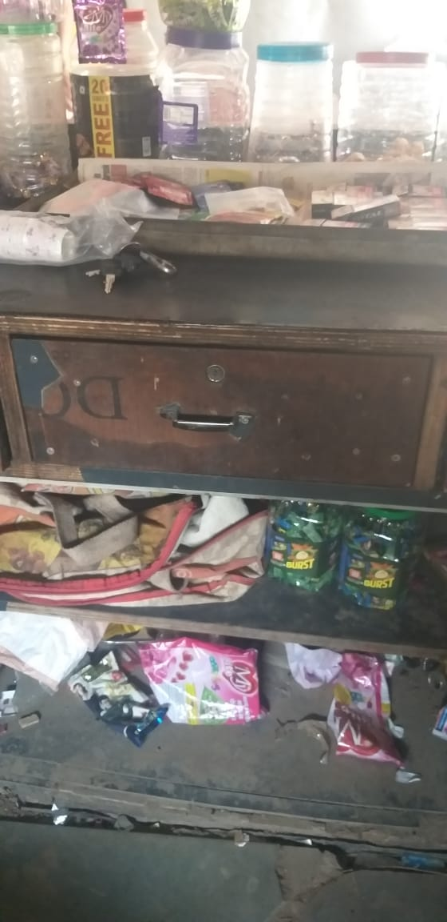
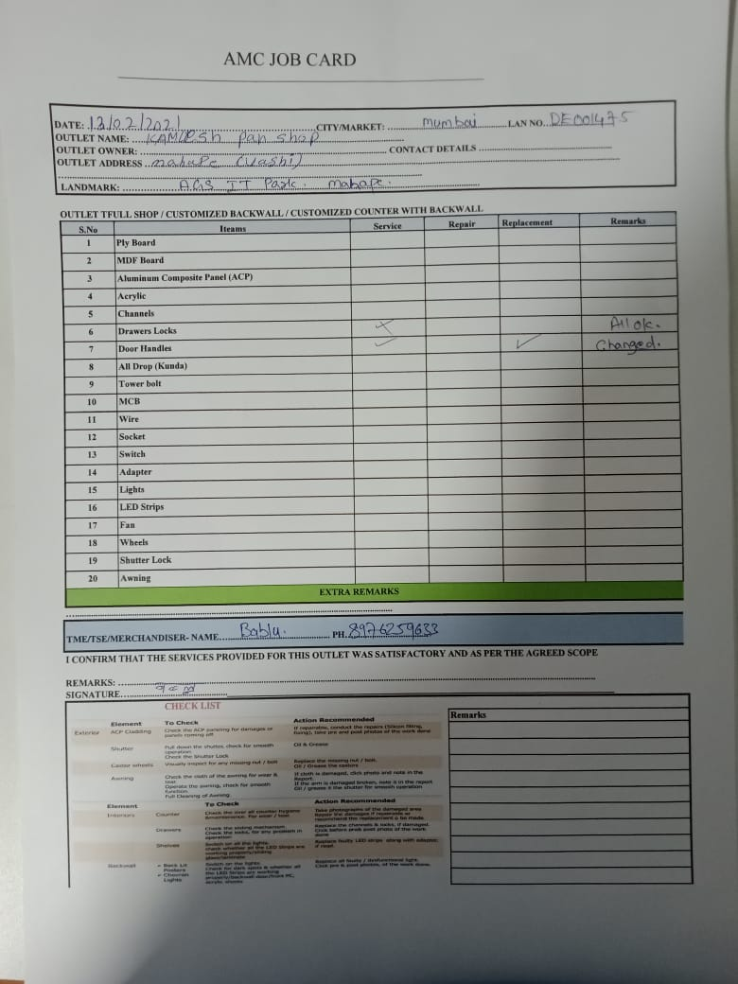
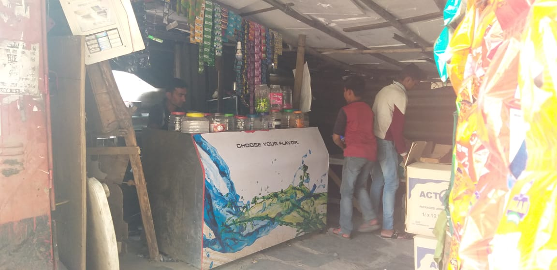
Outlet Name : KAMLESH PAN SHOP
Address : MAHAPE
LAN Code : DE001475
TSE : YUGAL RANJAN
Mumbai – Medium Impact

Slide 11
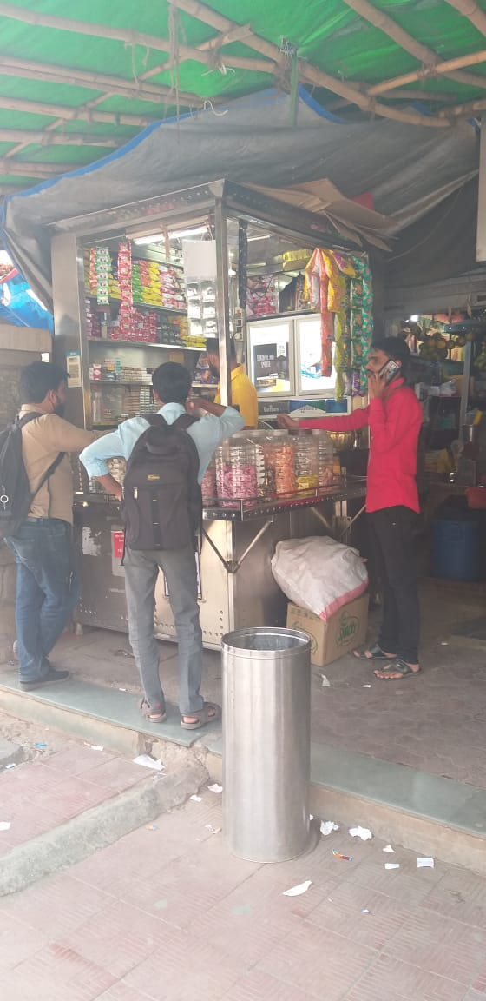
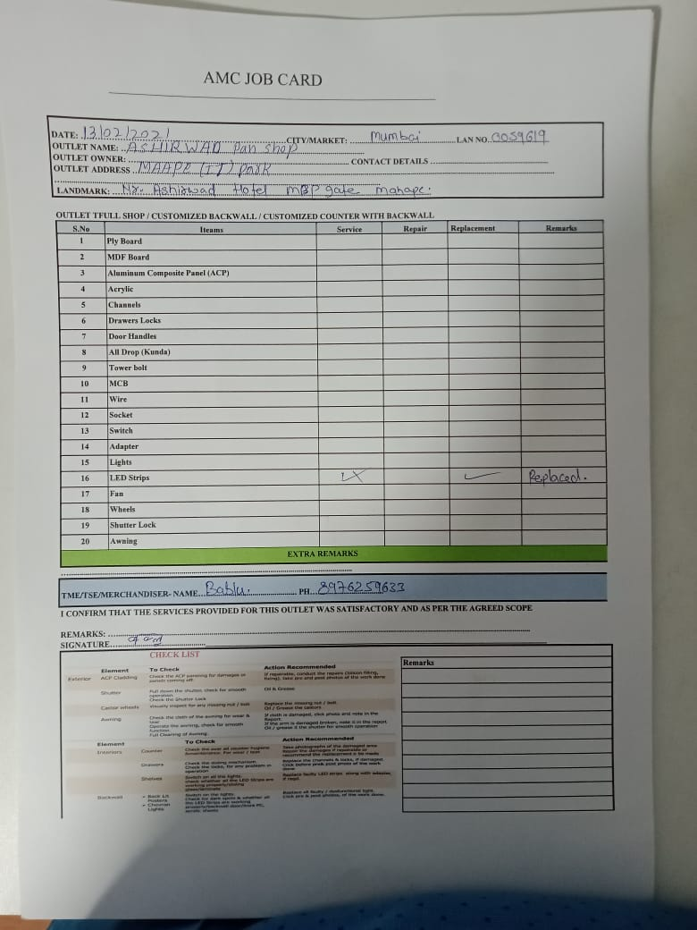
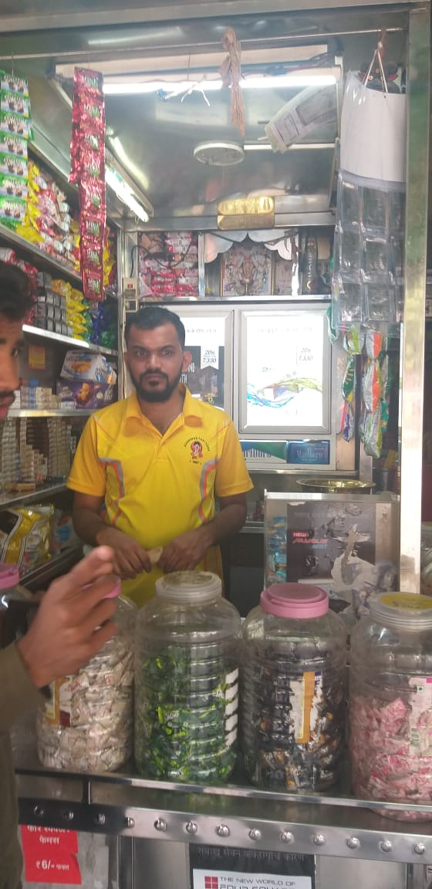
Outlet Name : ASHIRWAD PAN SHOP
Address : MAHAPE
LAN Code : LAN0059619
TSE : YUGAL RANJAN
Mumbai – Medium Impact

Slide 12
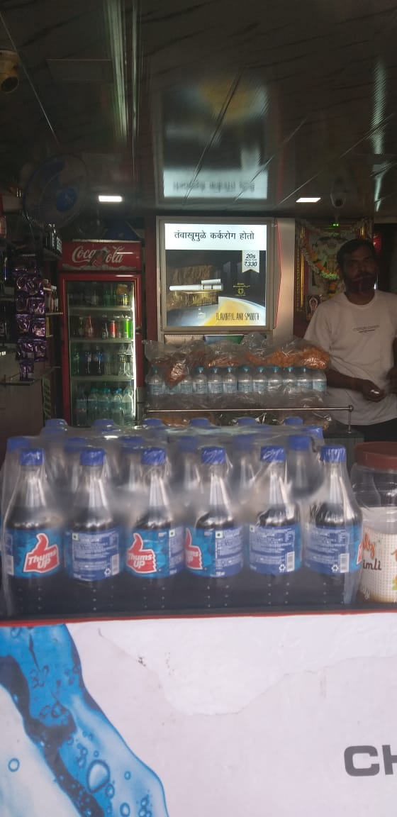
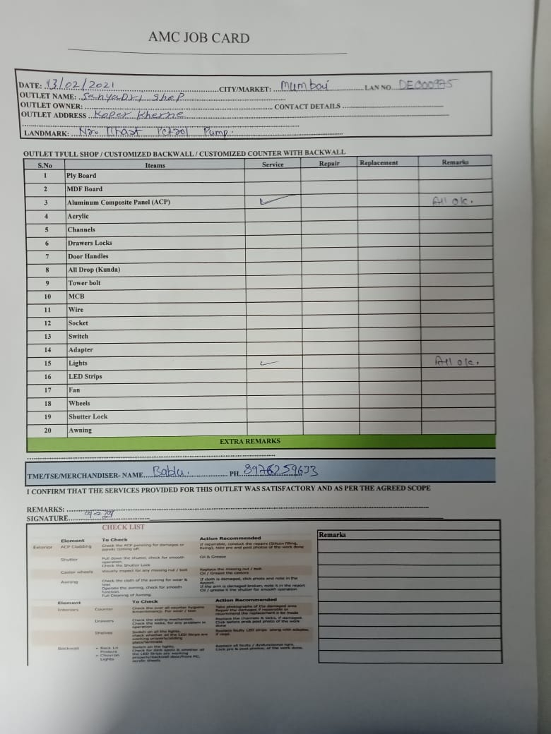
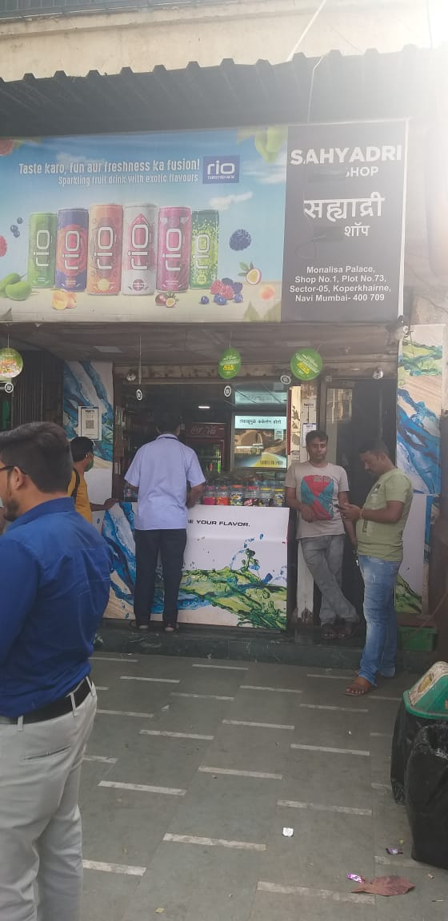
Outlet Name : SAHYADRI PAN SHOP
Address : KOPERKHAIRANE
LAN Code : DE000975
TSE : YUGAL RANJAN
Mumbai – Medium Impact

Slide 13
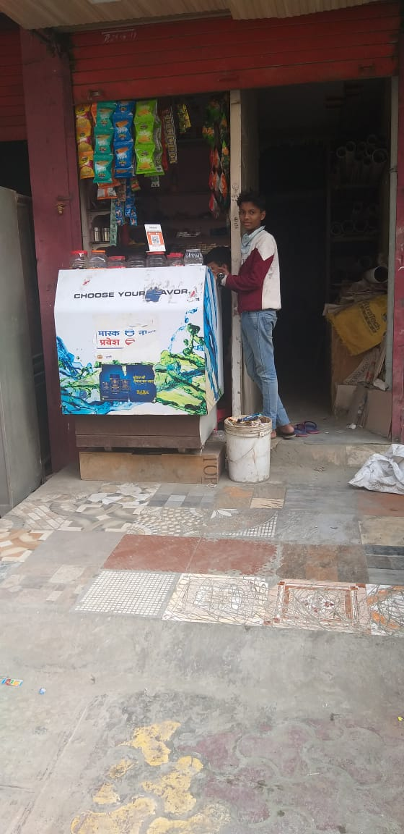
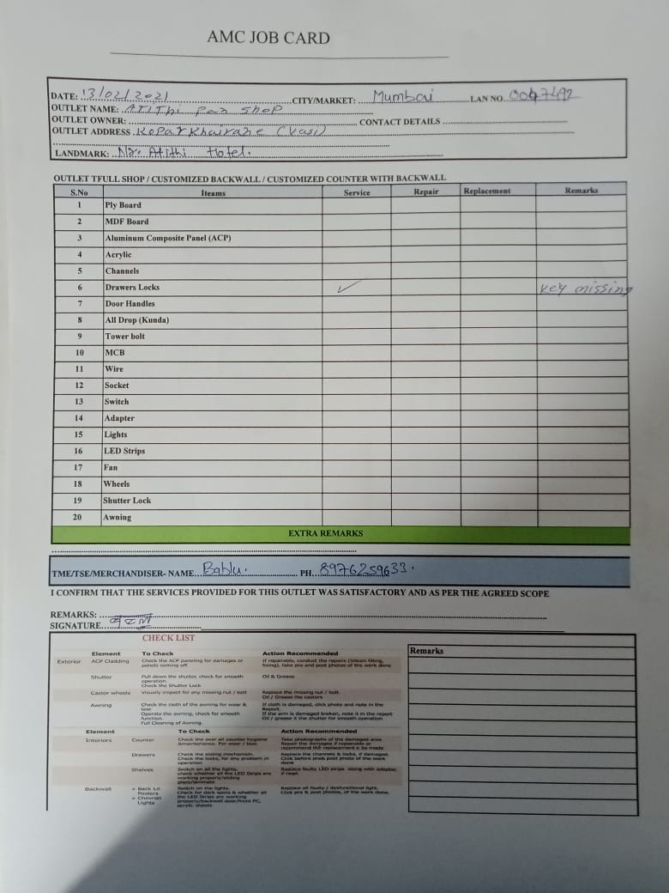
Outlet Name : ATITHI PAN SHOP
Address : KOPARKHAIRE
LAN Code : LAN0047492
TSE : YUGAL RANJAN
Mumbai – Medium Impact

Slide 14
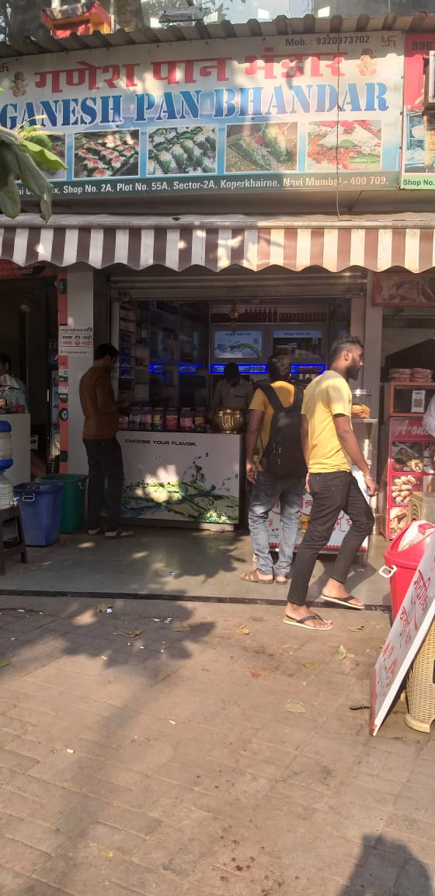
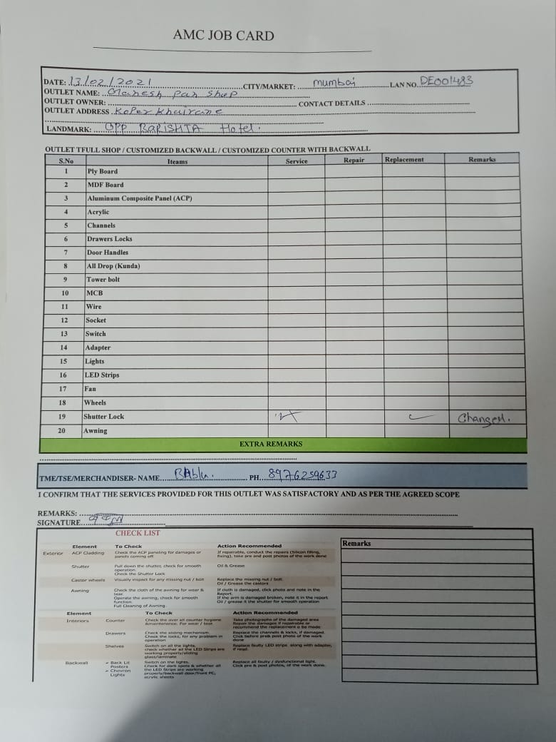
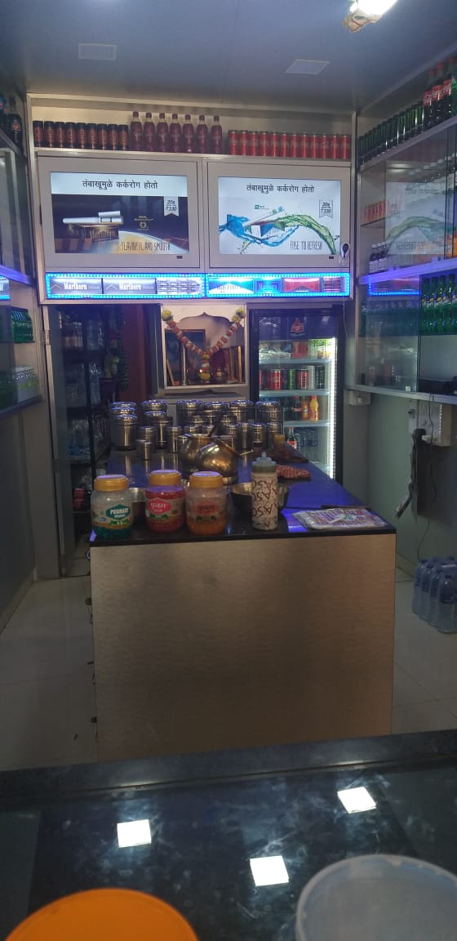
Outlet Name : SRI GANESH PAN SHOP
Address : KOPERKHAIRANE
LAN Code : DE001483
TSE : YUGAL RANJAN
Mumbai – High Impact

Slide 15
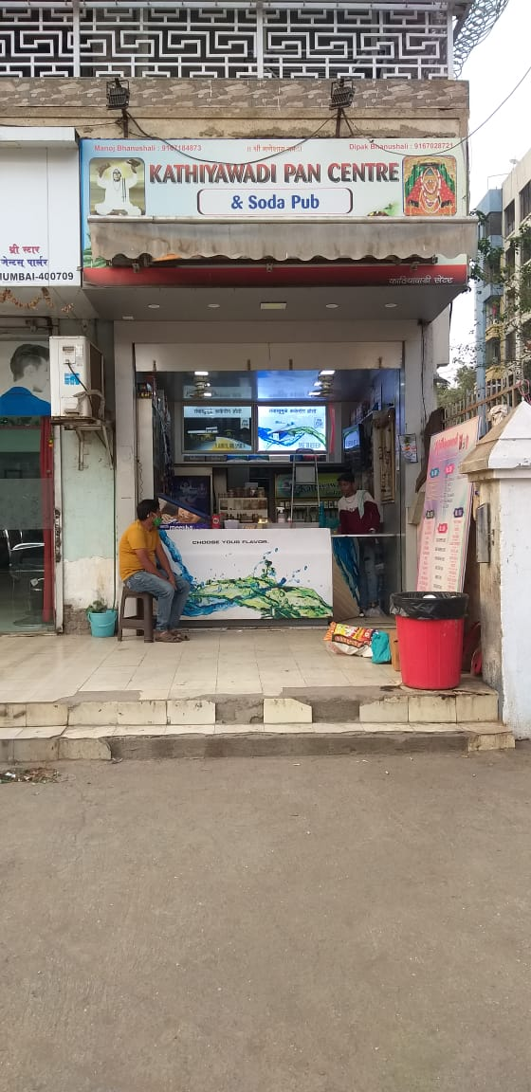
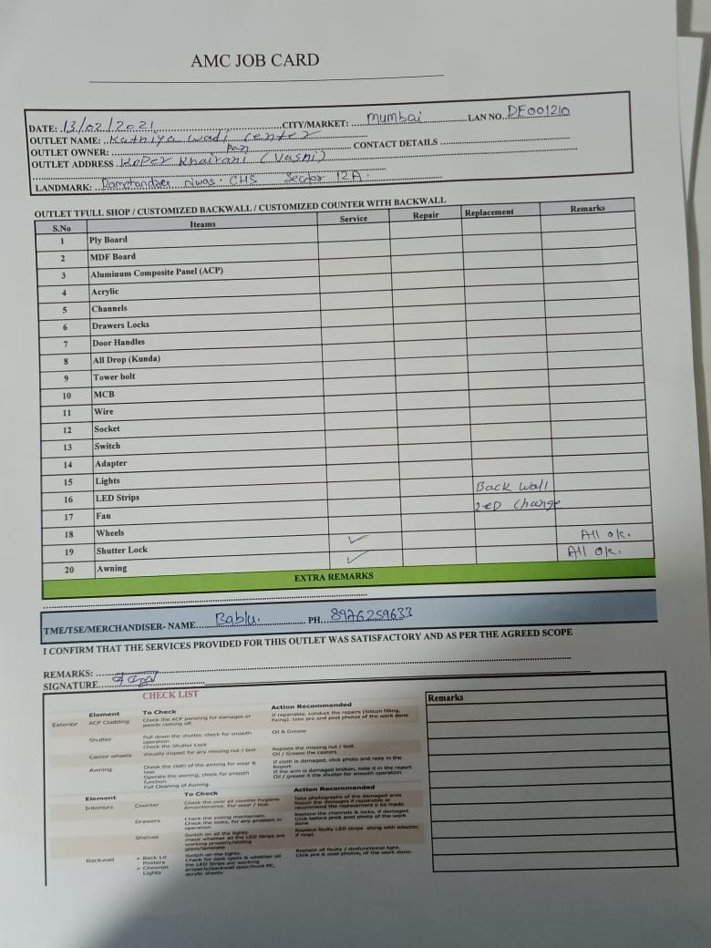
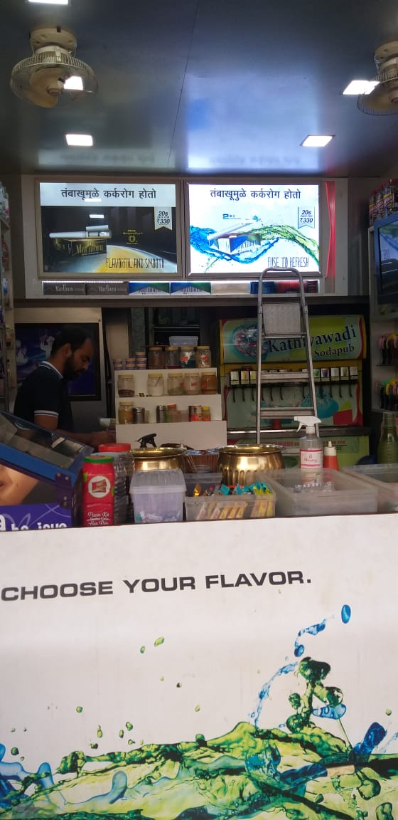
Outlet Name : KATHIYAWADI PAN SHOP
Address : KOPER KHAIRANE
LAN Code : DE001210
TSE : YUGAL RANJAN
Mumbai – High Impact

Slide 16
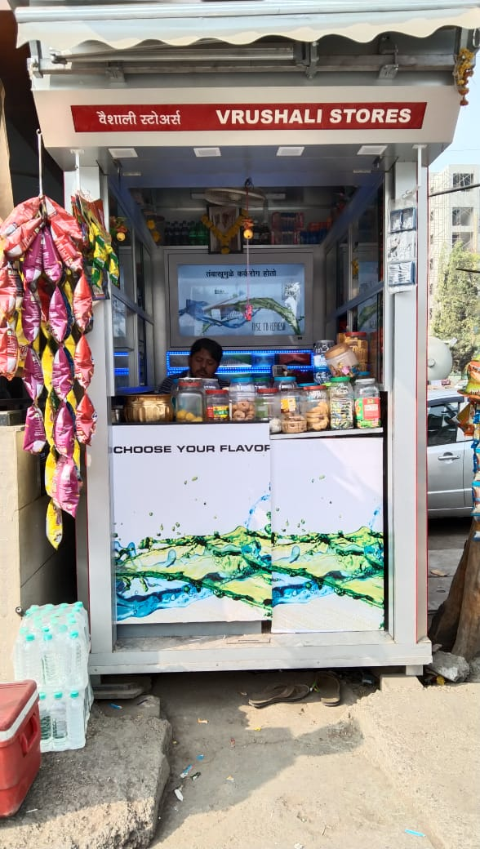
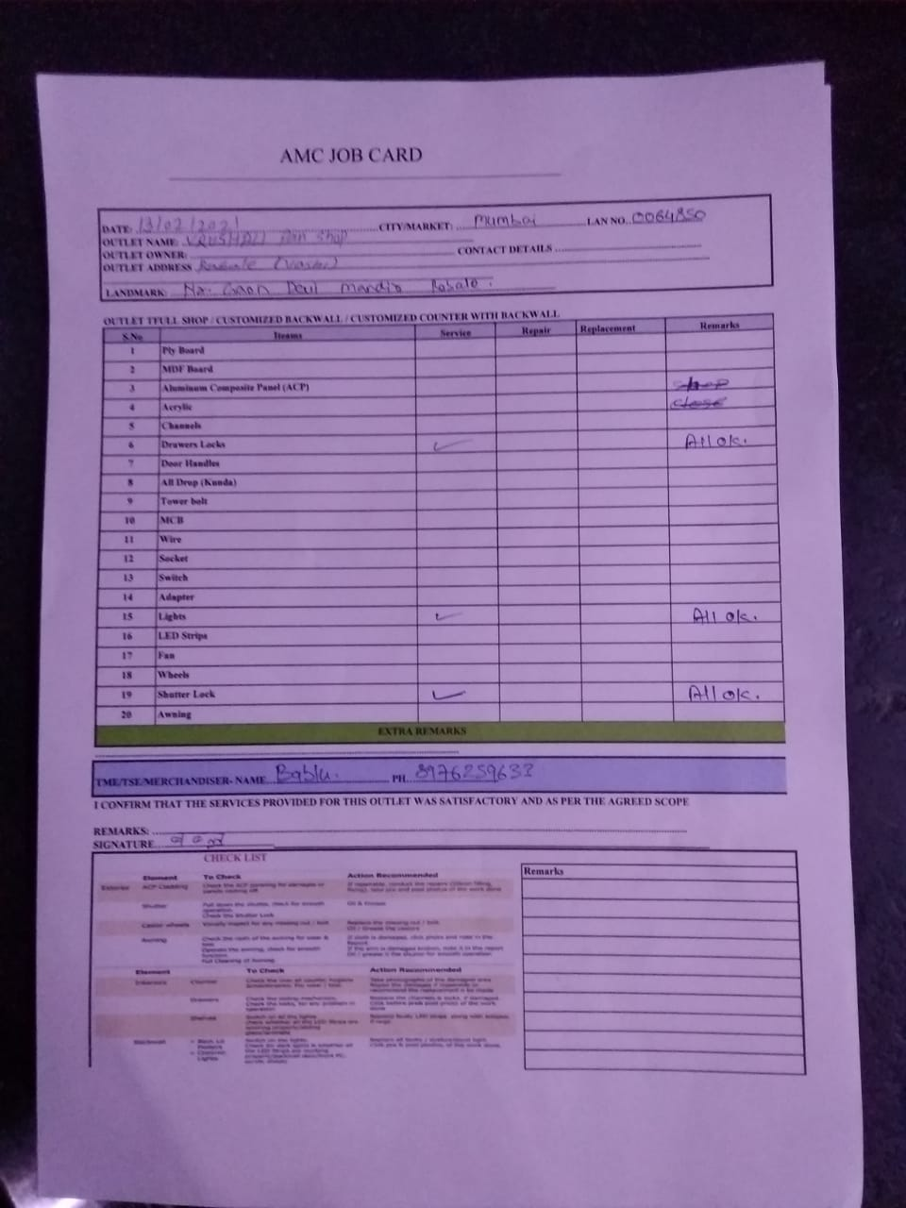
Outlet Name : VRISHALI PAN SHOP
Address : RABLE
LAN Code : LAN0064850
TSE : YUGAL RANJAN
Mumbai – High Impact

Slide 17
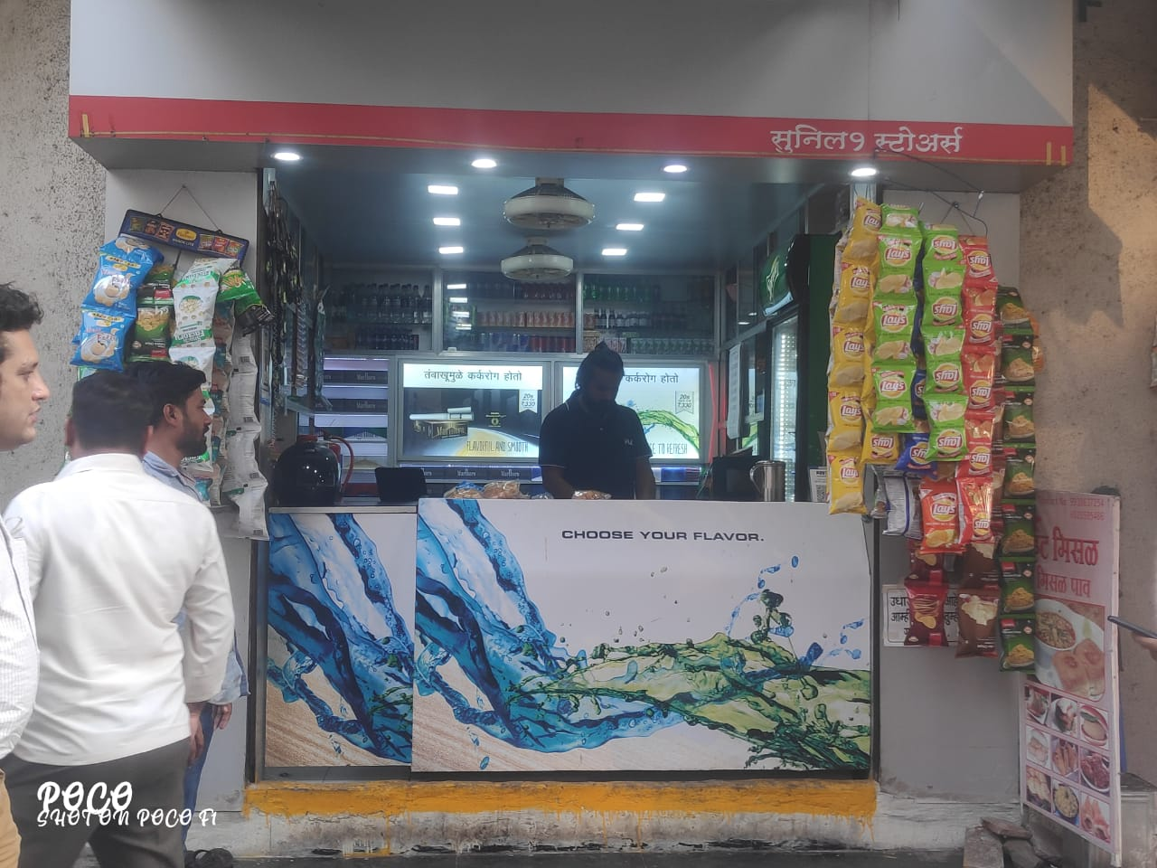
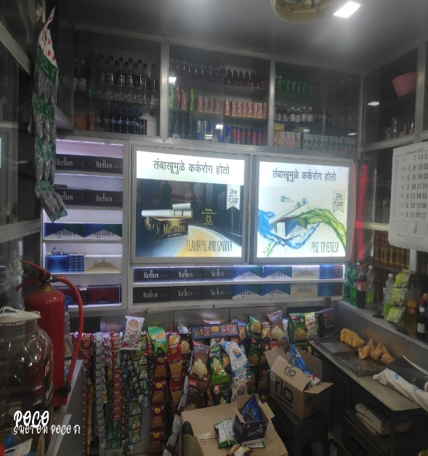
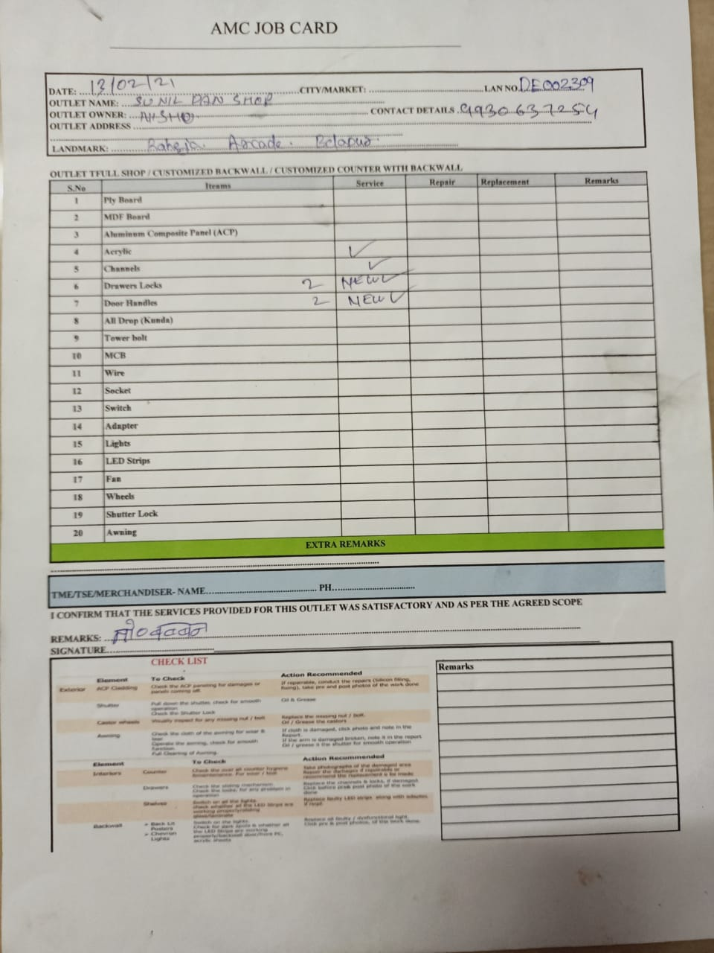


Outlet Name : SUNIL 1 PAN SHOP
Address : BELAPUR
LAN Code : DE002309
TSE : MAHESH JADHAV
Mumbai – High Impact

Slide 18




Outlet Name : GANGARAM PAN SHOP
Address : BELAPUR
LAN Code : DE000762
TSE : MAHESH JADHAV
Mumbai – Medium Impact

Slide 19



Outlet Name : KAIRALI PAN SHOP
Address : BELAPUR
LAN Code : DE000072
TSE :MAHESH JADHAV
Mumbai – Medium Impact

Slide 20




Outlet Name : SUNIL PAN SHOP
Address : BELAPUR
LAN Code : DE001487
TSE : MAHESH JADHAV
Mumbai – High Impact

Slide 21




Outlet Name : AKBAR PAN SHOP
Address : BELAPUR
LAN Code : DE002284
TSE : MAHESH JADHAV
Mumbai – Medium Impact

Slide 22





Outlet Name : HARI OM PAN SHOP
Address : BELAPUR
LAN Code : LAN0071577
TSE : MAHESH JADHAV
Mumbai – Medium Impact

Slide 23





Outlet Name : SALEEM P S
Address : BELAPUR
LAN Code : LAN0053226
TSE : MAHESH JADHAV
Mumbai – Medium Impact

Slide 24




Outlet Name : SHIV SAI PAN SHOP
Address : BELAPUR
LAN Code : DE001762
TSE : MAHESH JADHAV
Mumbai – High Impact

Slide 25





Outlet Name : SAI SAUKIN 2 PAN SHOP
Address : KHARGHAR
LAN Code : DE001488
TSE : MAHESH JADHAV
Mumbai – High Impact

Slide 26





Outlet Name : SAI SAUKIN 1 PAN SHOP
Address : KHARGHAR
LAN Code : DE001489
TSE : MAHESH JADHAV
Mumbai – Medium Impact

Slide 27





Outlet Name : SADGURU 2 PAN SHOP
Address : KHARGHAR
LAN Code : DE001499
TSE : MAHESH JADHAV
Mumbai – High Impact

Slide 28




Outlet Name : SAI PAN SHOP
Address : KHARGHAR
LAN Code : LAN0054014
TSE : MAHESH JADHAV
Mumbai – Medium Impact

Slide 29







Outlet Name : SAI NATH PAN SHOP
Address : NERUL
LAN Code : LAN0029434
TSE : MAHESH JADHAV
Mumbai – High Impact

Slide 30





Outlet Name : PRETISH PAN SHOP
Address : NERUL
LAN Code : LAN0059855
TSE : MAHESH JADHAV
Mumbai – Medium Impact

Slide 31




Outlet Name : SONU PAN SHOP
Address : SANPADA
LAN Code : DE000160
TSE :YUGAL RANJAN
Mumbai – High Impact

Slide 32



Outlet Name : TRIDEV PAN SHOP
Address : SANPADA
LAN Code : MU003385
TSE : YUGAL RANJAN
Mumbai – High Impact

Slide 33





Outlet Name : SAHYADRI PAN SHOP
Address : SANDAPA
LAN Code : DE000975
TSE :YUGAL RANJAN
Mumbai – Medium Impact

Slide 34



Outlet Name : KAMAT PAN SHOP
Address : SANPADA
LAN Code : LAN0041219
TSE :YUGAL RANJAN
Mumbai – Medium Impact

Slide 35




Outlet Name : SATKAR PAN SHOP
Address : BELAPUR
LAN Code : LAN0029361
TSE :MAHESH JADAV
Mumbai – High Impact

Slide 36




Outlet Name : SHIVAM PAN SHOP
Address : BELAPUR
LAN Code : LAN0060582
TSE :MAHESH JADAV
Mumbai – High Impact

Slide 37





Outlet Name : BANARSI PAN SHOP
Address : BELPAUR
LAN Code : DE001260
TSE :MAHESG JADHAV
Mumbai – High Impact

Slide 38





Outlet Name : NEHA PAN SHOP
Address : BELAPUR
LAN Code : DE001367
TSE :MAHESH JADAV
Mumbai – Medium Impact

Slide 39



Outlet Name : DEVI JYOTI PAN SHOP
Address : SANPADA
LAN Code : LAN0050340
TSE :YUGAL RAJAN
Mumbai – High Impact

Slide 40





Outlet Name : TRIMURTI SHOP
Address : SANPADA
LAN Code : LAN0029187
TSE :YUGAL RAJAN
Mumbai – High Impact

Slide 41





Outlet Name : BABA PAN SHOP
Address : BELAPUR
LAN Code : DE000813
TSE :MAHESH JADAV
Mumbai – Medium Impact

Slide 42




Outlet Name : YUVRAJ PAN SHOP
Address : SANPADA
LAN Code : LAN0037946
TSE :YUGAL RAJAN
Mumbai – High Impact

Slide 43



Outlet Name : MUNNA PAN SHOP
Address : SANPADA
LAN Code : LAN0029021
TSE :YUGAL RAJAN
Mumbai – High Impact

Slide 44



Outlet Name : VADEHI PAN SHOP
Address : SANPADA
LAN Code : LAN0029835
TSE :YUGAL RAJAN
Mumbai – Medium Impact

Slide 45



Outlet Name : MUNNA PAN SHOP
Address : SANPADA
LAN Code : DE001482
TSE :YUGAL RAJAN
Mumbai – High Impact

Slide 46





Outlet Name : OM PAN SHOP
Address : BELAPUR
LAN Code : DE000841
TSE :MAHESH JHADAV
Mumbai – Medium Impact

Slide 47





Outlet Name : POOJA PAN SHOP
Address : SANPADA
LAN Code : LAN0050342
TSE :YUGAL RAJAN
Mumbai – High Impact

Slide 48





Outlet Name : BOMAY HIGH-1 PAN SHOP
Address : BELAPUR
LAN Code : LAN0066171
TSE :MAHESH JADHAV
Mumbai – High Impact

Slide 49


Outlet Name : CHOWHAN PAN SHOP
Address : BELAPUR
LAN Code : MU003674
TSE :MAHESH JADHAV
Mumbai – Medium Impact

Slide 50


Outlet Name : SAI SHRADHA PAN SHOP
Address : BELAPUR
LAN Code : LAN0029321
TSE :MAHESH JADHAV
Mumbai – High Impact

Slide 51
Outlet Name : KASHI PAN SHOP
Address : THANE
LAN Code : DE001736
TSE :SACHIN DEVADIGA
Mumbai – High Impact

Slide 52
Outlet Name : KASHI PAN SHOP
Address : THANE
LAN Code : DE001736
TSE :SACHIN DEVADIGA
Mumbai – High Impact

Slide 53
Outlet Name : KASHI PAN SHOP
Address : THANE
LAN Code : DE001736
TSE :SACHIN DEVADIGA
Mumbai – High Impact

Slide 54
Outlet Name : KASHI PAN SHOP
Address : THANE
LAN Code : DE001736
TSE :SACHIN DEVADIGA
Mumbai – High Impact

Slide 55
Outlet Name : KASHI PAN SHOP
Address : THANE
LAN Code : DE001736
TSE :SACHIN DEVADIGA
Mumbai – High Impact

Slide 56
Outlet Name : KASHI PAN SHOP
Address : THANE
LAN Code : DE001736
TSE :SACHIN DEVADIGA
Mumbai – High Impact

Slide 57
Outlet Name : KASHI PAN SHOP
Address : THANE
LAN Code : DE001736
TSE :SACHIN DEVADIGA
Mumbai – High Impact

Slide 58
Outlet Name : KASHI PAN SHOP
Address : THANE
LAN Code : DE001736
TSE :SACHIN DEVADIGA
Mumbai – High Impact

